Slide 1

f_{esc}: The Biggest “My Results Aren’t Quite Correct” Dial Ever
Jacob Seiler
Anne Hutter, Darren Croton, Emma Ryan-Weber

Slide 2
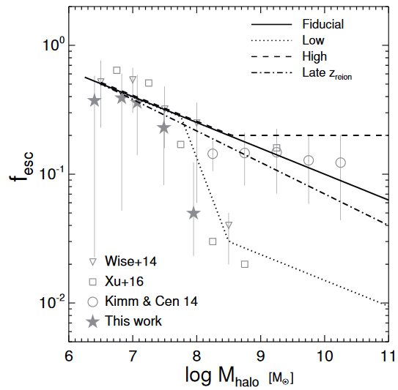
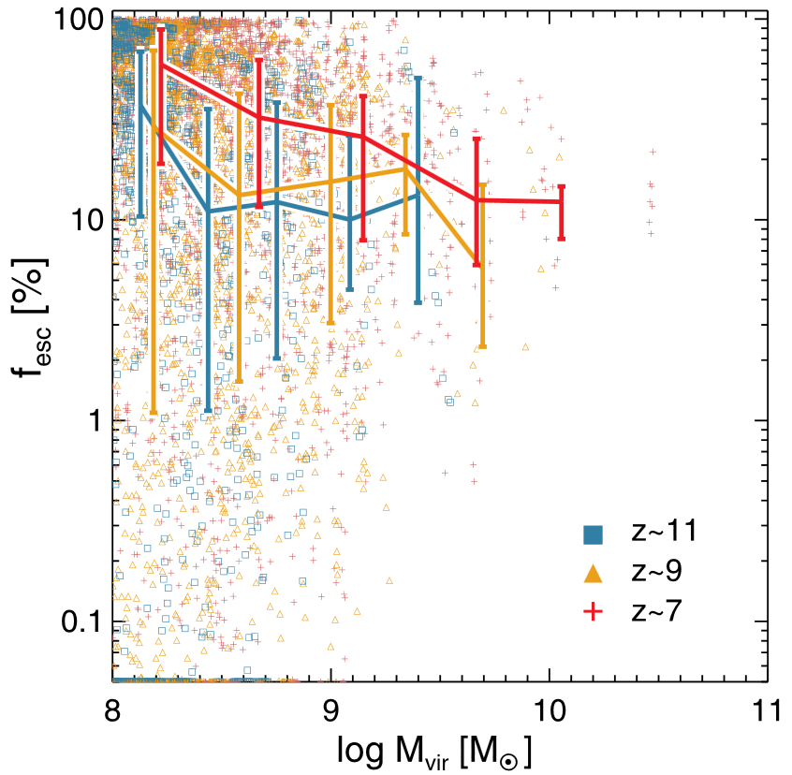
Why? Because It’s Easy!
Normally just assume constant escape fraction.
(Kimm et al., 2016)
(Kimm & Cen, 2014)

Slide 3
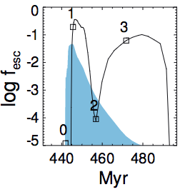
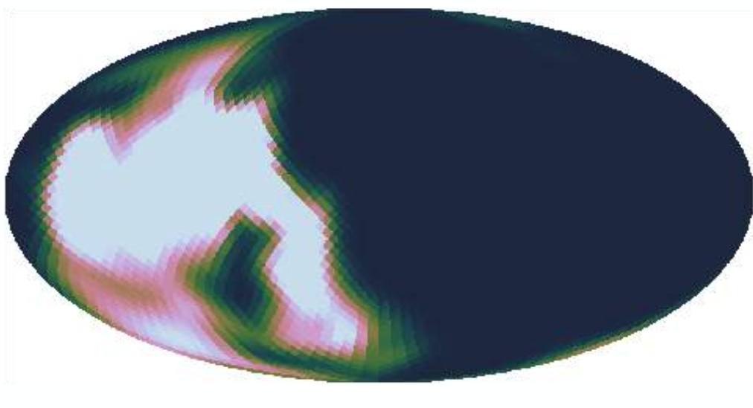
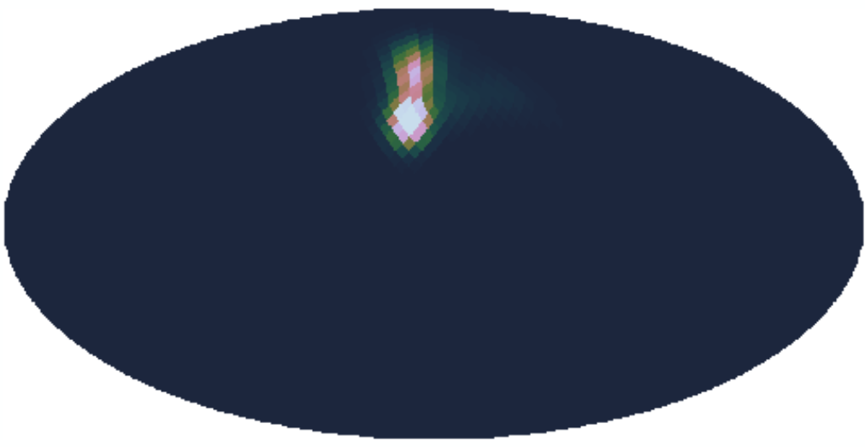
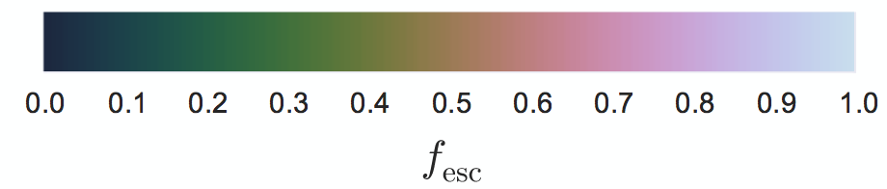
Why? Because It’s Easy!
Normally just assume constant escape fraction.
SN Blowout
Radiation Feedback
(Kimm et al., 2016)
(Paardekooper 2015)

Slide 4
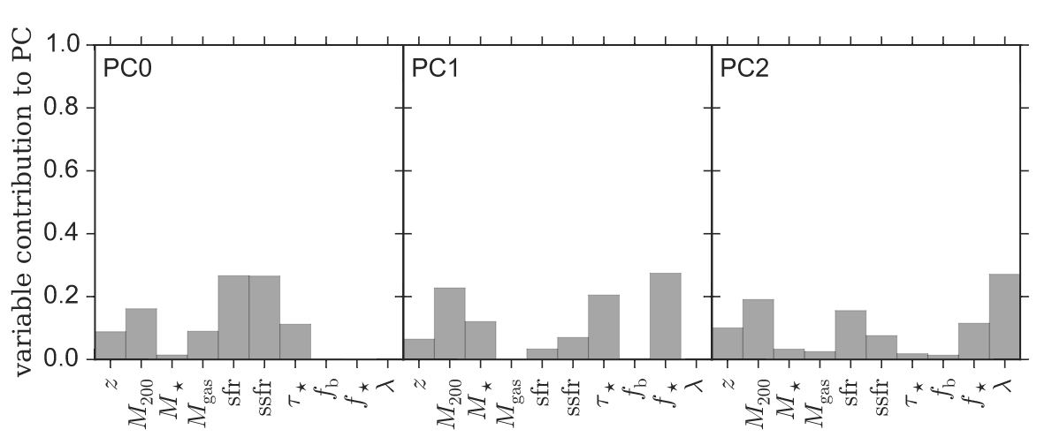
Why? Because It’s Easy!
Normally just assume constant escape fraction.
(Paardekooper 2015)

Slide 5
Our Aim
Is it possible to model the Epoch of Reionization using a more physically motivated escape fraction parameterization?
What are the `key’ observations/measurements/results that we have to match?

Slide 6
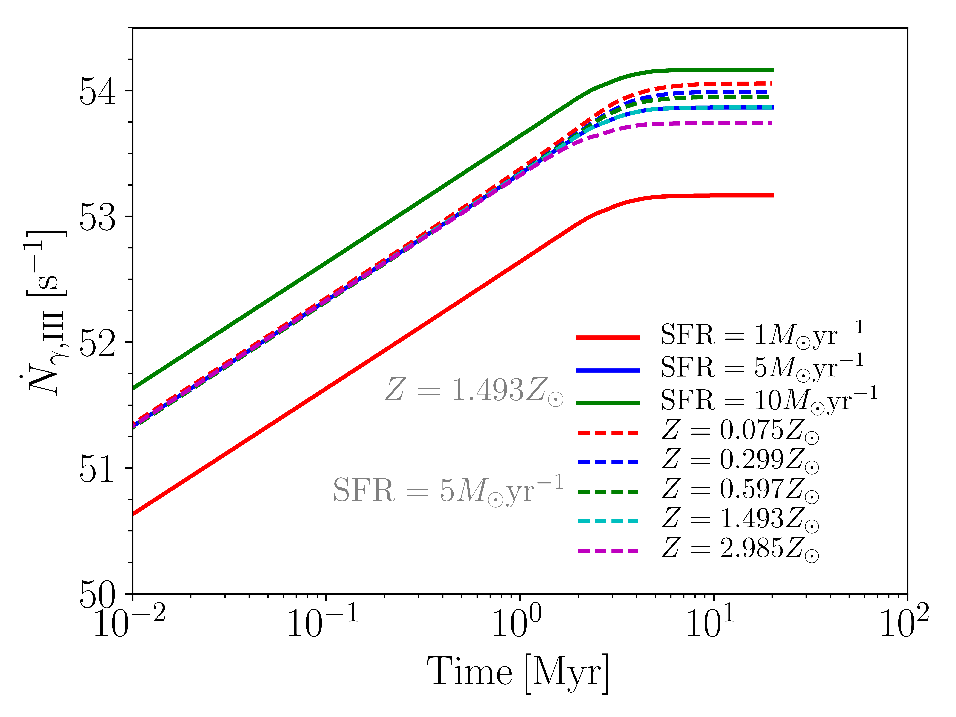
Ionizing Photons
Use a galaxy based ionizing photon prescription that depends upon the galaxies SFR.
Can use local galaxy properties to determine f_{esc}.

Slide 7
Ionizing Photons
Use a galaxy based ionizing photon prescription that depends upon the galaxies SFR.
Can use local galaxy properties to determine f_{esc}.
Only takes like 15 minutes!

Slide 8

SAGE Can Only Handle Thyme
A
B
Notes:
So we have this semi-analytic model that handles the evolution of galaxies in a temporal direction. We want to add to this a description of the spatially distributed diffuse gas. We want this in such a way that the evolution of the galaxies affects the diffuse gas and the diffuse gas affects the galaxies. As a result, our first attempt was to overlay a grid. As a result each galaxy will live in a cell filled with diffuse gas. When there are ejection events that move gas from a reservoir outside of the halo (such as supernova winds), then the gas will be added to the grid cell. When there is an event that moves gas from outside of the halo into a reservoir (such as reincorporation), then the gas will be subtracted from the grid cell. However halos are processed on a tree by tree basis. These trees only contain the progenitors of a halo meaning that two halos that do not share a common progenitor or merge in the future will NEVER talk to each other.
Say you have galaxy A, this galaxy is in the first tree that is processed. It evolves and ejects and accretes from the grid cell happily. At some point in its evolution it travels into this cell here. Now at this point in our work we have chosen a cell size of ~500Kpc. As a result, it is entirely plausible for two galaxies to be in the same cell but never interact with each other. As a result, galaxies A and B are completely blind to each other’s evolution. Since A is processed first then, it is blind to all of the accretion and ejection events of galaxy B; the value of the grid cell will be INCORRECT from galaxy A’s point of view.
So this grid is an incomplete solution to our issue; there will be uneven evolution of galaxies.

Slide 9
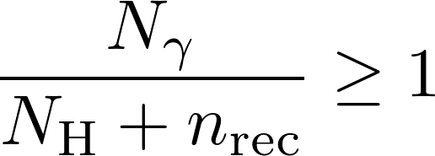
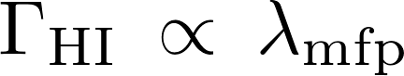
Bubble Model
Web Model
Excursion set formalism.
Draw spheres of decreasing radius
Count number of ionizing photons + neutral H + recombinations
Calculates sub-cell neutral hydrogen fraction.
Takes into account self-shielding + local photoionization rate.

Slide 10
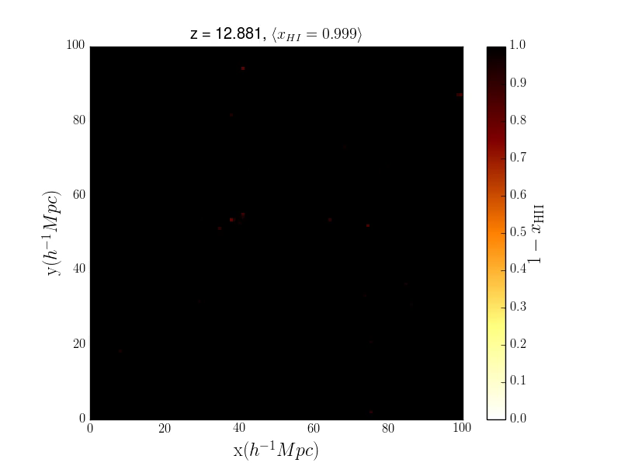
Semi-Numerical Model

Slide 11


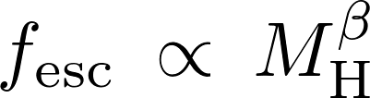




Escape Fraction Parameterization
Sample Text

Slide 12
Preliminary Results

Slide 13
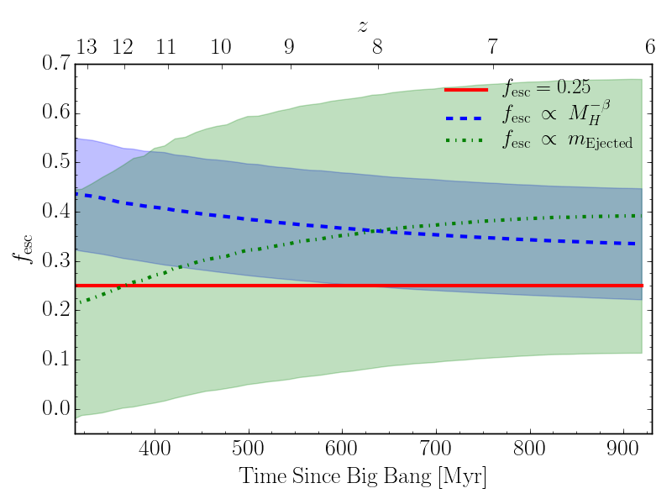
Preliminary Results

Slide 14
Preliminary Results

Slide 15
Preliminary Results

Slide 16
Summary
Use Semi-Analytic Galaxy Evolution to determine galaxy properties + ionizing photons.
Parameterize f_{esc} using local galaxy/halo properties.
Post process using Bubble+Web to model reionization.
f_{esc} prescription can affect morphology and shape of reionization.
Next: <<<Insert something about what I’m going to do next.>>>

